Slide 1
Azure Data factory-Monitoring

Slide 2
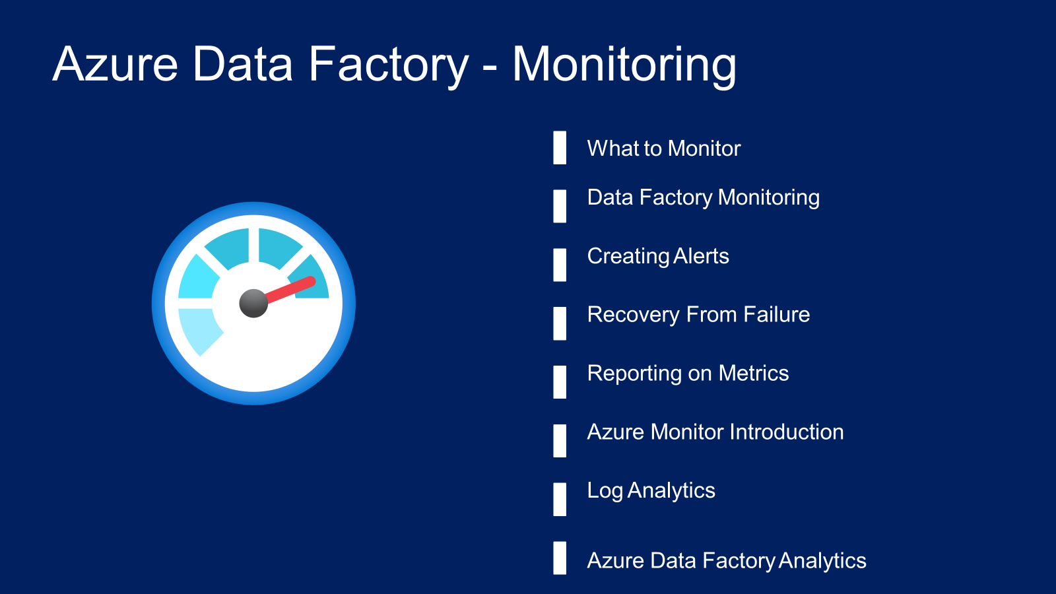

Slide 3
What do we want to monitor
Azure Data Factory Resource
Integration runtime
Trigger runs
Pipeline runs
Activity runs

Slide 4
Data Factory Monitor
Ability to monitor status of pipeline/ triggers
Can be used to re-run failed pipelines/ triggers
Ability to send alerts from base level metrics
Provides base level metrics and logs
Pipeline runs are stored only for 45 days

Slide 5
Azure Monitor
Ability to route the diagnostic data to other storage solutions
Provides richer diagnostic data
Ability to write complex queries and custom reporting
Ability to report across multiple data factories

